Slide 1

Major Project Presentation
TOPIC : Design and Develop a Centralized Freelancing Platform
Presented By
Bijoy Pantu – 27600122048
Sharad Kumar -- 27600122221
Rishika Kumari – 27600122190
Koustav Mondal – 27600122051
Muntazir Alam – 27600122155
Supervisor : Mrs. Atreyee Datta
Department Of Computer Science & Engineering
Budge Budge Institute Of Technology
July 20, 2026

Slide 2

OBJECTIVE
Connect freelancers and employers through a single centralized platform
Showcase skills, experience, and portfolios in a professional format
Enable efficient job posting with smart search and filtering
Implement secure, escrow-based payments for trust and transparency
Boost job accessibility and income opportunities in India's gig economy.

Slide 3
Page - 3
ABSTRACT
The Challenge
Our Solution
India's gig economy is expanding rapidly, driven by urbanization, growing internet penetration, and rising demand for remote work. Yet global platforms like Upwork and Fiverr fall short here - high fees, no India-specific payment support, and job postings that are often vague or poorly structured, leaving small Indian businesses and freelancers without a platform built for their needs.
A centralized platform purpose-built for the Indian market:
Targeted specifically at small Indian businesses and local employers
Structured job posting for clearer, more detailed project descriptions
Smart search and filtering to match freelancers with the right work
UPI-integrated, escrow-based secure payments
Milestone tracking for project accountability
Real-time chat between freelancers and employers

Slide 4
Page - 4
LITERATURE REVIEW
Global Platforms Studied
Key Limitations for Indian Users
Upwork - Bidding-based marketplace with hourly/fixed-price contracts and built-in time tracking
Fiverr - Fixed-price "gig" catalogue model, popular for smaller, well-defined tasks
Freelancer.com - Combines competitive bidding with skill-based contests
Toptal - Exclusive, invite-only platform screening for top-tier, enterprise-grade talent
High service fees, ranging from 10–20% of freelancer earnings
Payment delays from cross-border banking and currency conversion
No India-specific payment gateways or localized job categories
Intense global competition makes it hard for new freelancers to land their first project
Weak dispute resolution and support for region-specific concerns

Slide 5
Page - 5
System Architecture
Frontend
Backend
Database
React.js + Tailwind CSS
Modern, responsive UI
Node.js + Express
Scalable server
architecture
MongoDB
Flexible document
storage

Slide 6
Page - 6
Core Platform Features
For Freelancers
For Employers
Comprehensive Profiles
Skills, portfolio, experience, and certifications
Project Posting
Define requirements, budget, and timeline easily
Job Search & Filtering
Browse and filter projects by skill, budget, and category
Advanced Search
Filter by skills, experience, ratings, and rates
Portfolio Showcase
Visual work samples and detailed case studies
Analytics Dashboard
Track project progress and spending insights
Secure Escrow Payments
Milestone-based earnings released safely via Razorpay
Direct Communication
In-platform secure messaging system

Slide 7
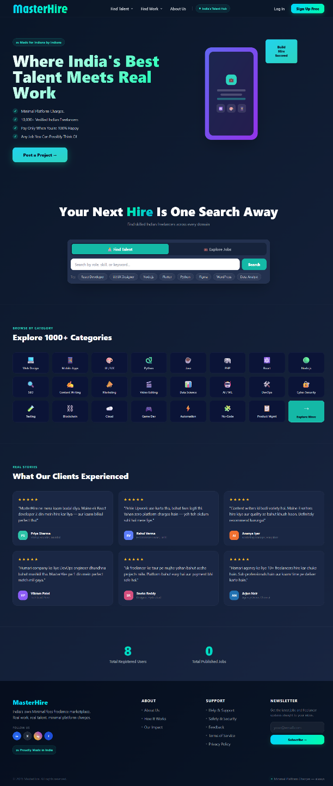
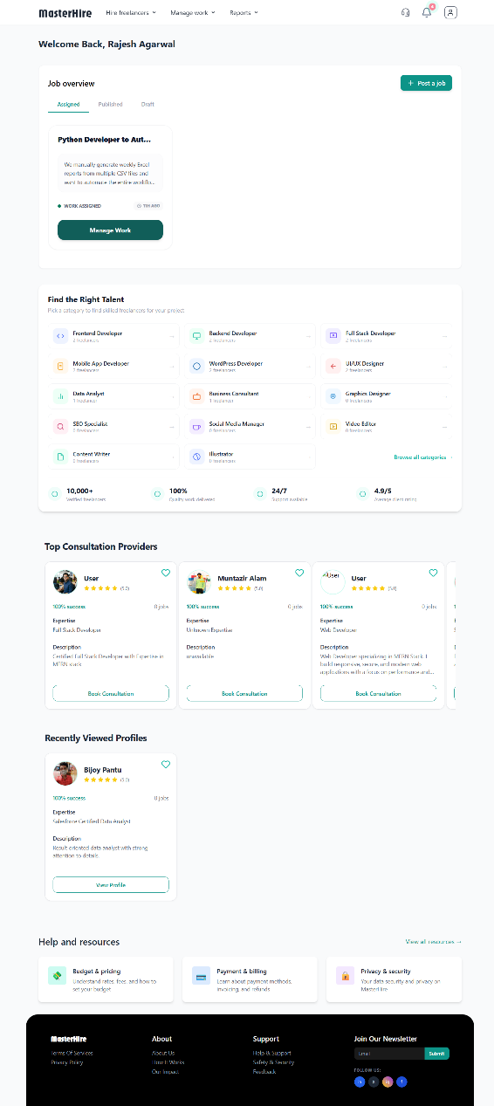
OVERVIEW OF USER INTERFACE
Page - 7
Landing page
Client Dashboard

Slide 8
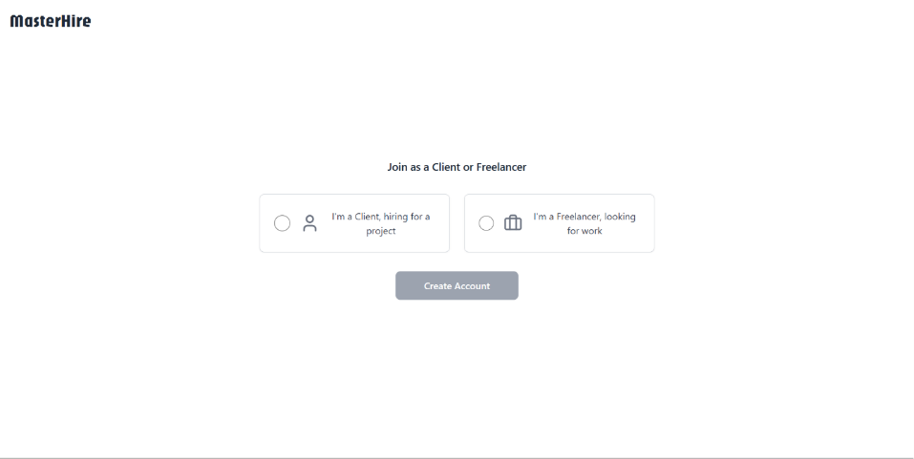
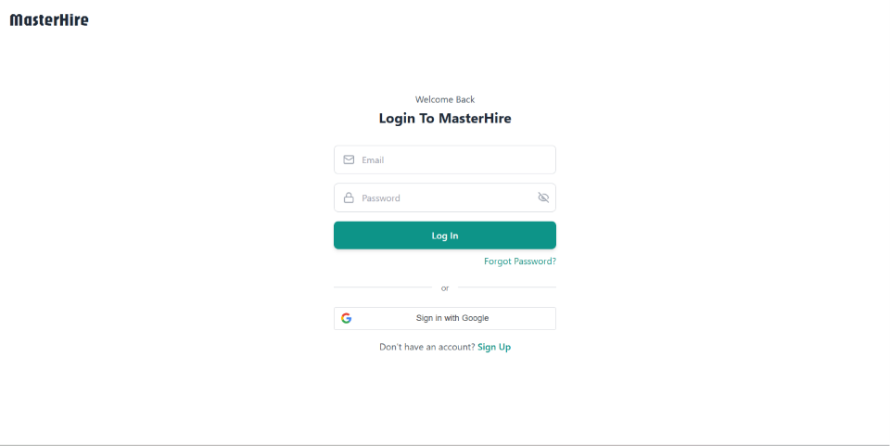
OVERVIEW OF USER INTERFACE
Page - 8
Sign-up Page
Log in Page

Slide 9
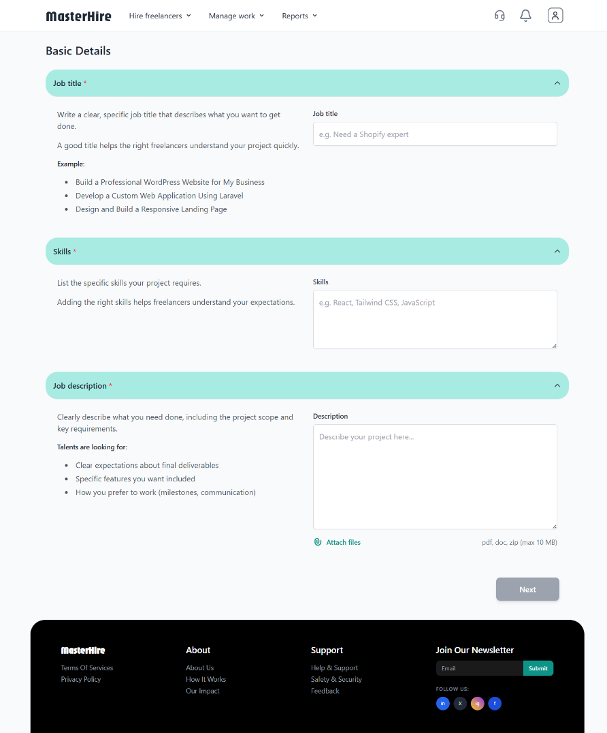
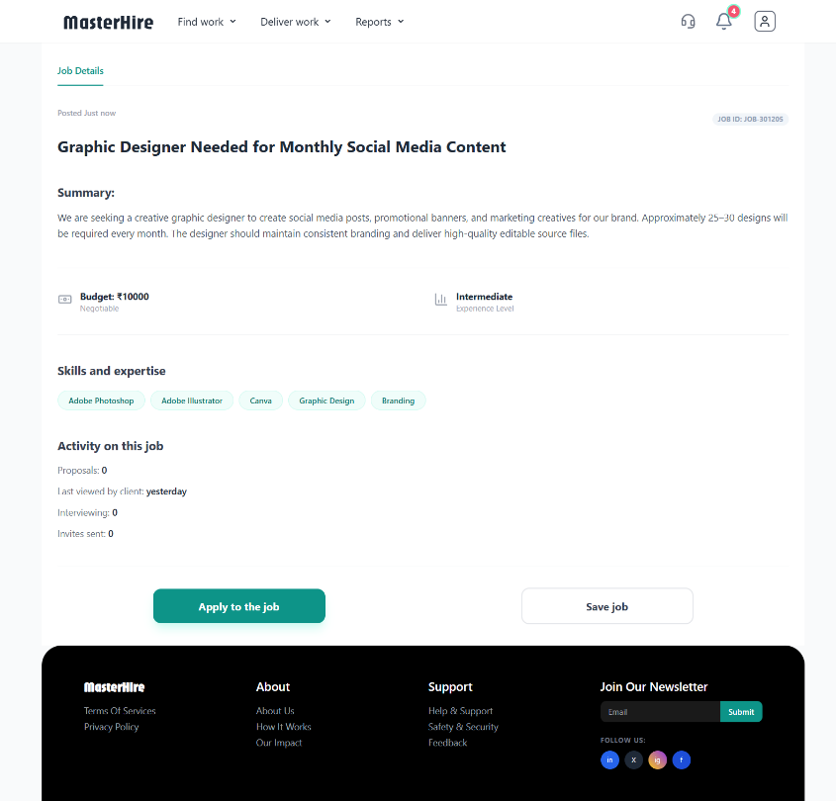
OVERVIEW OF USER INTERFACE
Page - 9
Job Posting Page
Job Application Page

Slide 10
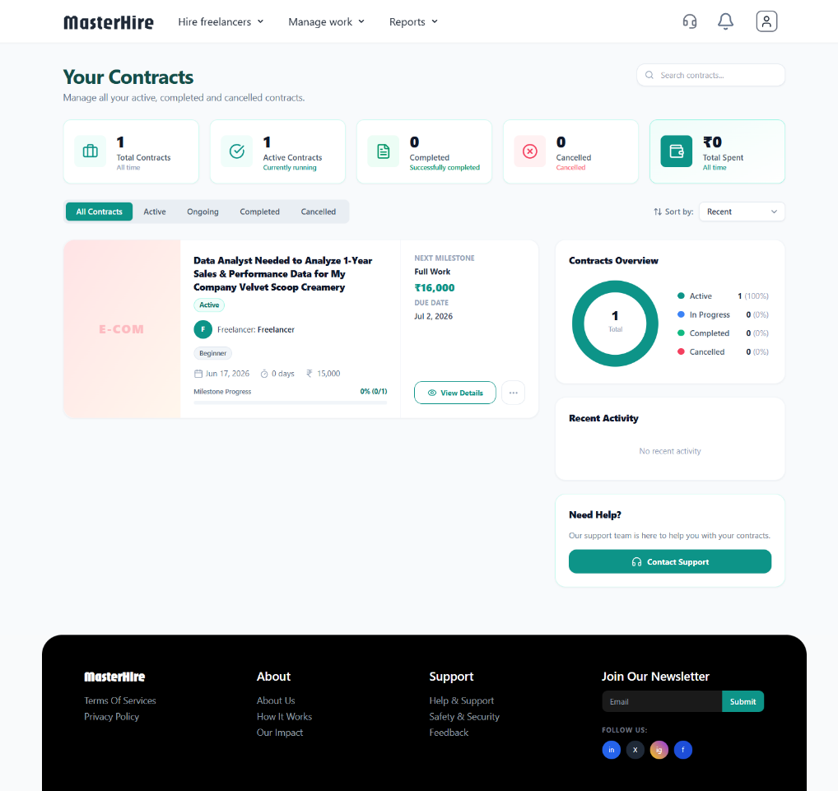
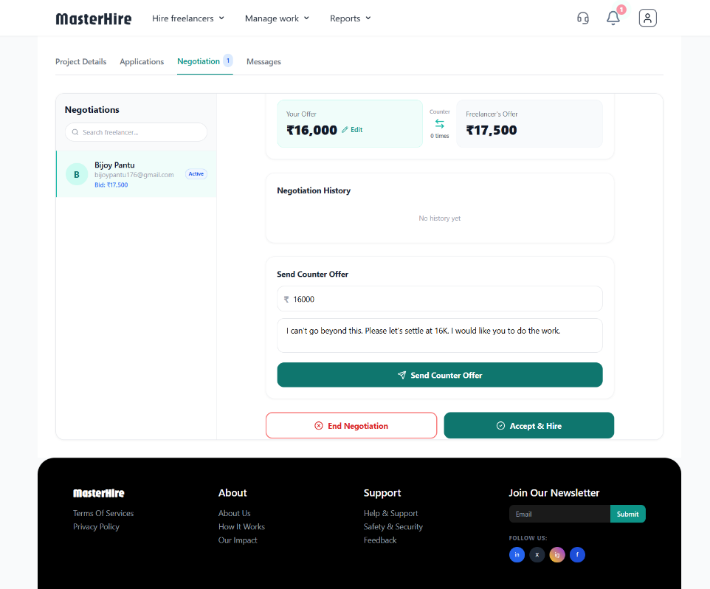
OVERVIEW OF USER INTERFACE
Page - 10
Simplified Contracts view
Job Negotiation View

Slide 11
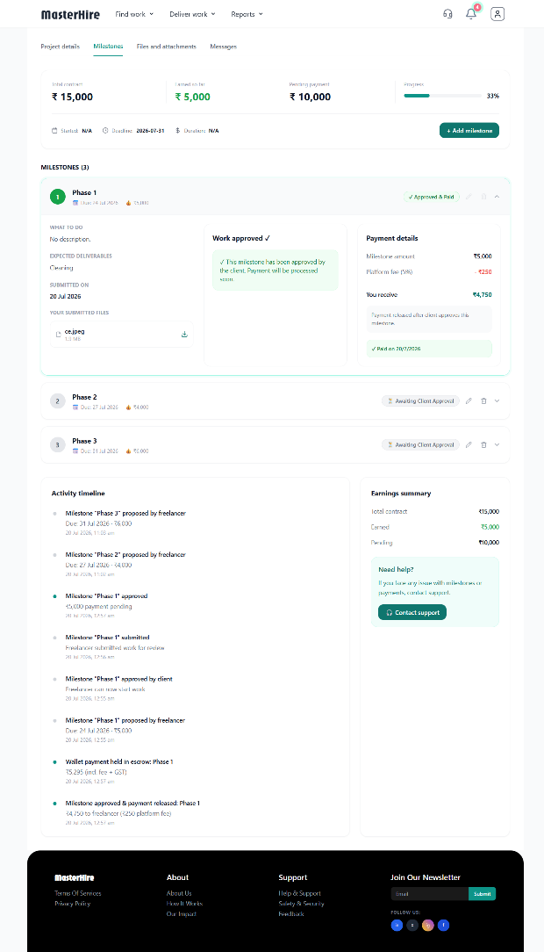
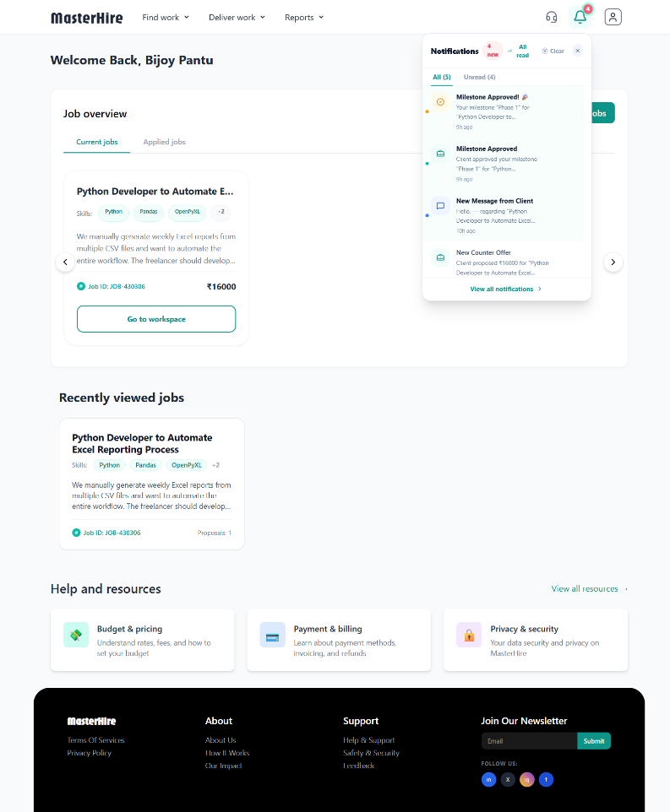
OVERVIEW OF USER INTERFACE
Page - 11
Milestone System With Activity Timeline
Real-time Notification

Slide 12
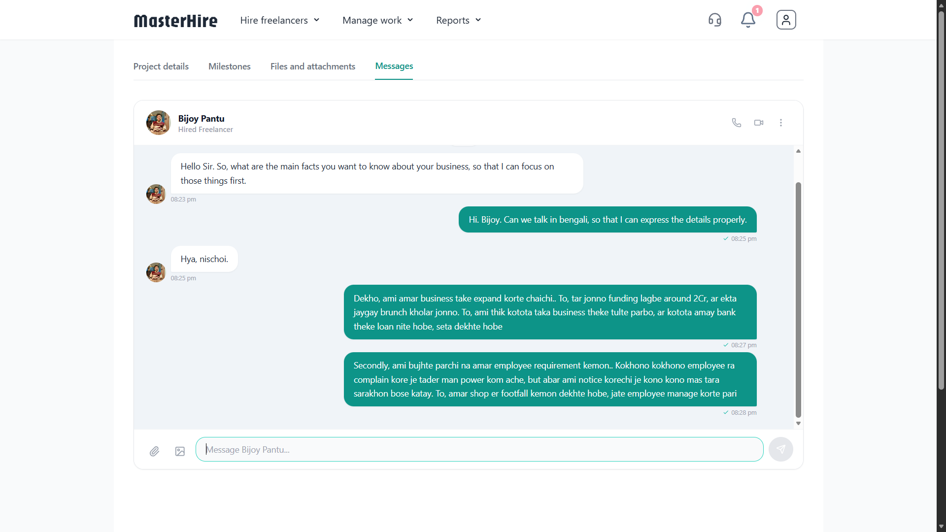
OVERVIEW OF USER INTERFACE
Page - 12
Live Chat System

Slide 13
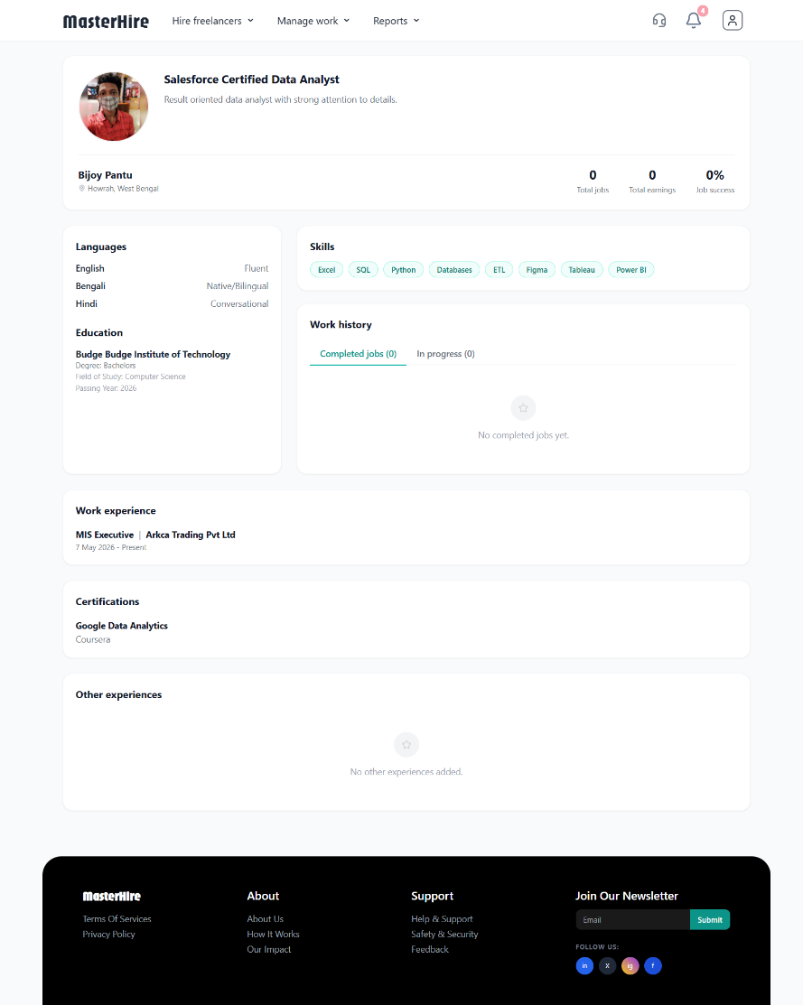
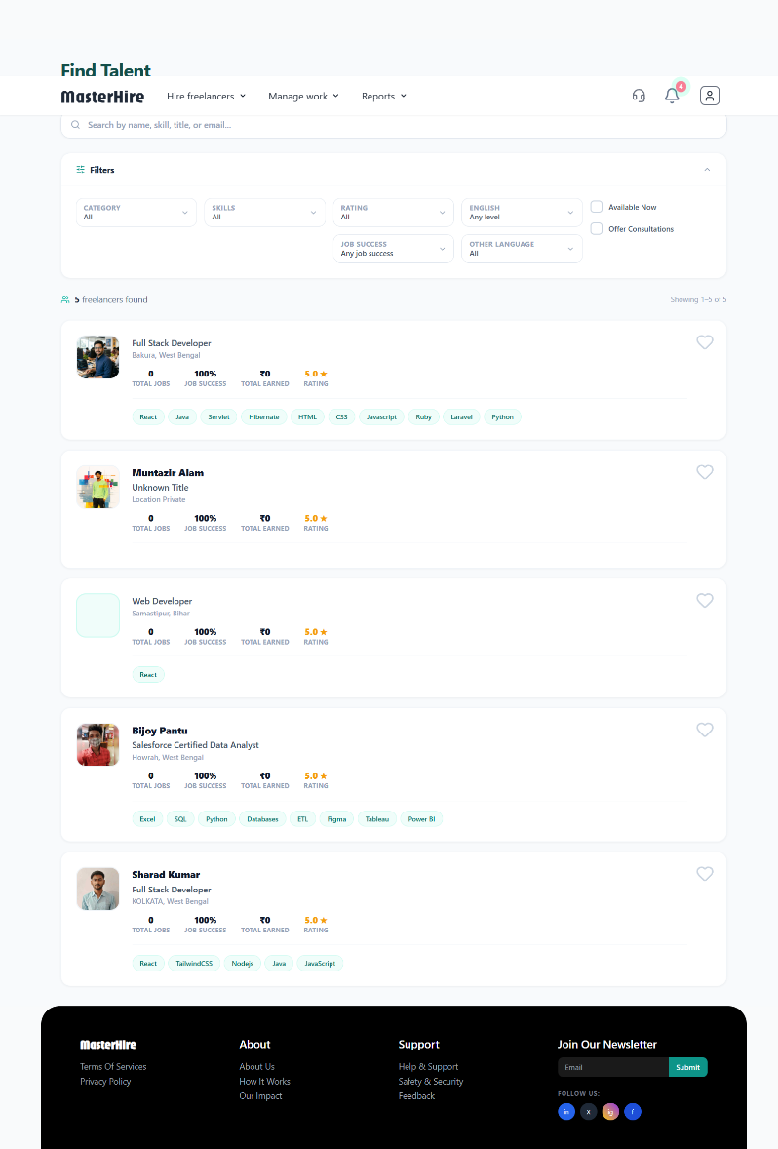
OVERVIEW OF USER INTERFACE
Page - 13
Simplified Profile view
Freelancer searching page

Slide 14
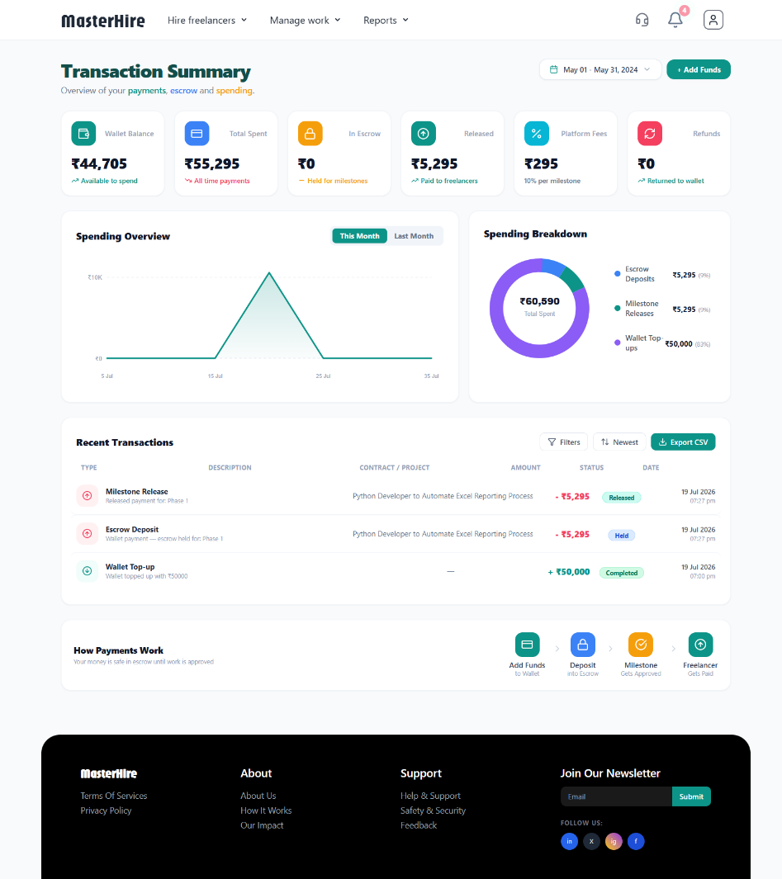
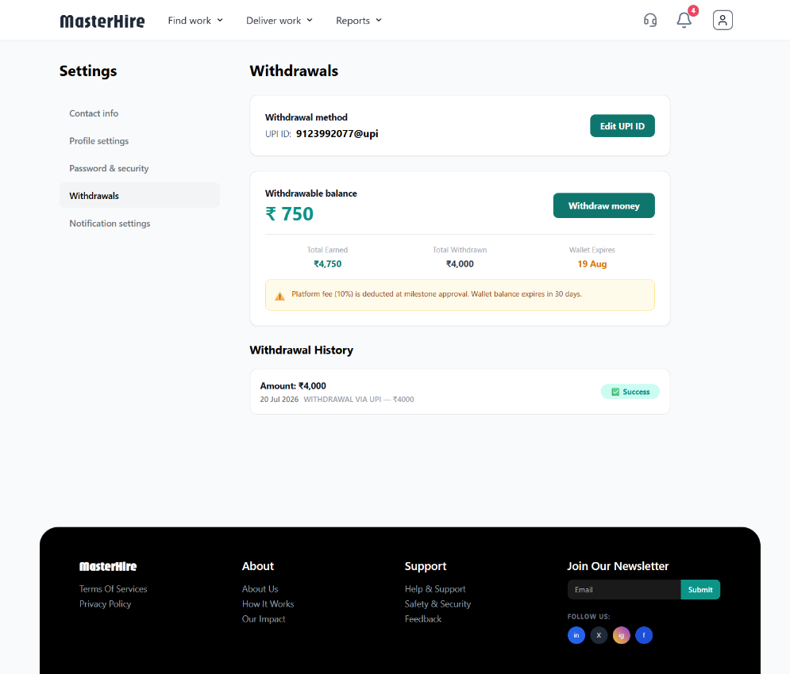
OVERVIEW OF USER INTERFACE
Page - 14
Spending Analytics dashboard
Freelancer wallet mechanism

Slide 15
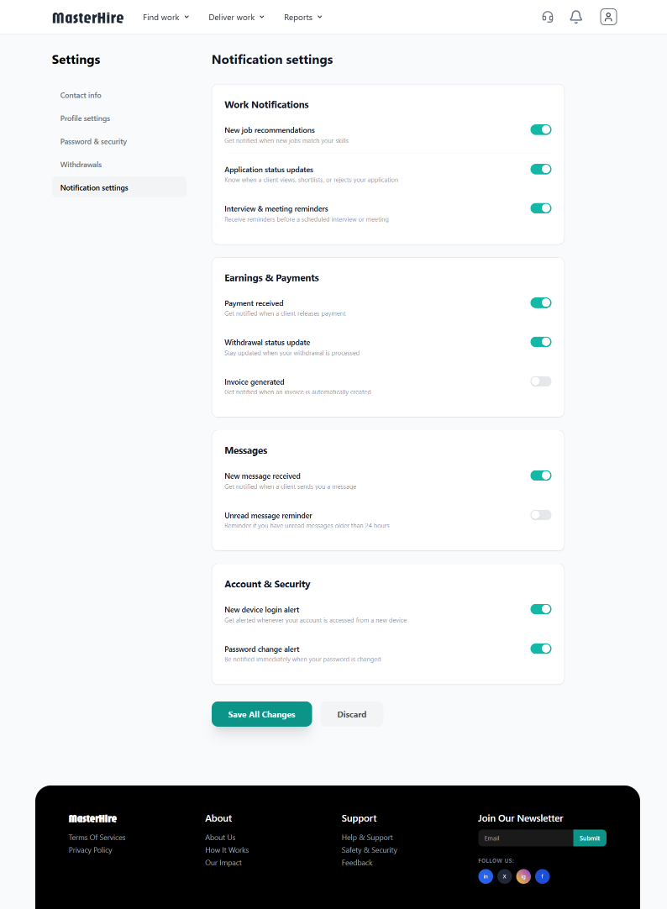
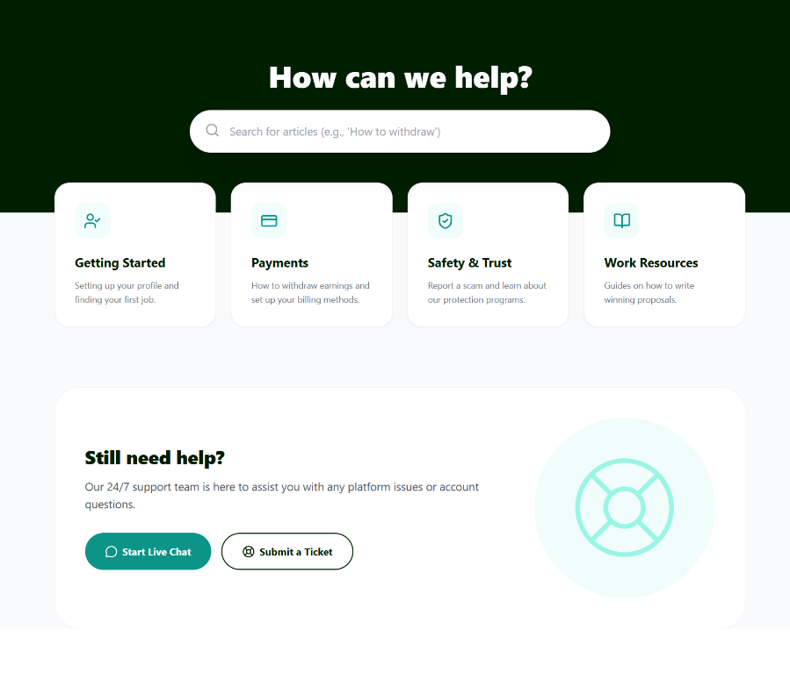
OVERVIEW OF USER INTERFACE
Page - 15
Simplified Settings Page
24/7 Client Support

Slide 16
Page - 16
FUTURE WORK
Advanced AI Features
• Proactive skill-gap analysis and suggestions for freelancers
• AI-assisted project scoping and requirement generation for employers
• Predictive analytics for project success rates
Localization & Integration
• Seamless UPI integration for instant payments
• Automated TDS compliance and tax documentation
• Multi-language support for Tier 2/3 city accessibility
Platform Expansion
• Industry-specific vertical marketplaces
• Native mobile applications (iOS and Android)
• Advanced collaboration tools and workspace features

Slide 17
Page - 17
CONCLUSION
This freelancing platform addresses the growing need for a reliable and structured system to connect freelancers and employers in India's expanding gig economy.
By integrating comprehensive profile management, structured job posting, secure escrow payments, and milestone-based tracking, the platform significantly enhances:
Operational efficiency for both parties
Transparency in transactions and communications
User trust through verified ratings and secure payments
Overall, the system contributes to improved employment accessibility, better utilization of skilled talent, and supports the sustainable growth of India's freelance ecosystem.

Slide 18

Page - 18

